Slide 1
Lunar Space Rover Terrain Navigation Simulation
Denis Akola, Raman Kumar Jha

Slide 2
Motivation
Relative Terrain Navigation (RTN) — is a localization technique that allows a vehicle (e.g., a rover, spacecraft, missile, or drone) to determine its position relative to known terrain features by comparing onboard sensor data with a stored terrain map or model.
Why is this relevant?
GPS-denied environments: Works where GPS is unavailable or unreliable (e.g., Mars, lunar surface, underwater, or jammed zones).
Autonomous operation: Essential for spacecraft landings (e.g., NASA’s Perseverance rover), autonomous drones, and military guidance systems.

Slide 3
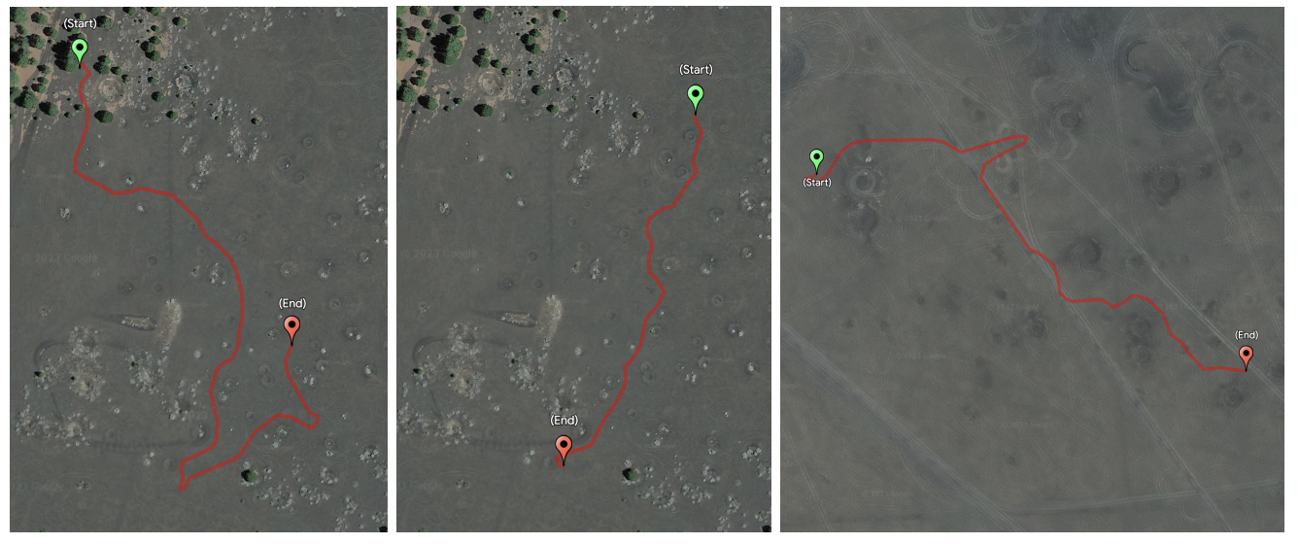
Related Work
LunarNav introduces a crater-based localization system for lunar rovers that matches locally detected craters with orbital maps to achieve global positioning without GNSS.
ShadowNav proposes a vision-based localization system that operates in permanently shadowed lunar regions by leveraging illumination-invariant features from shadow patterns.

Slide 4
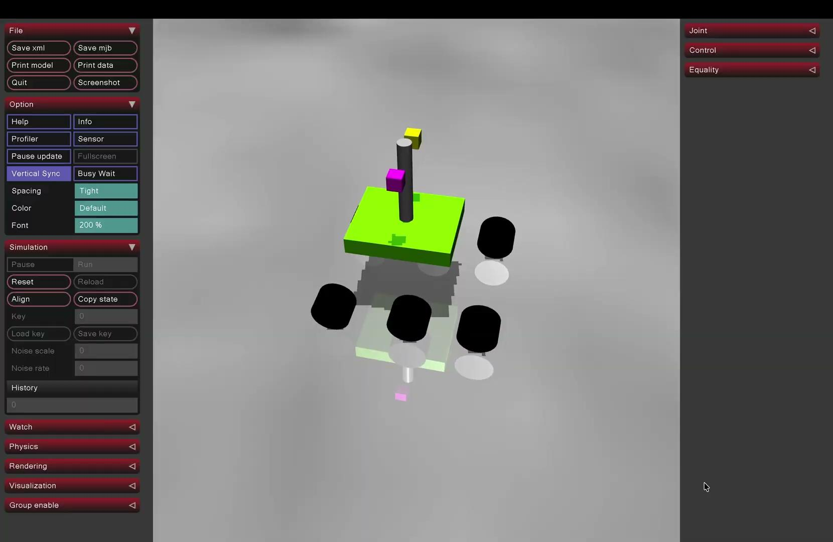
MuJoCo Simulation

Slide 5
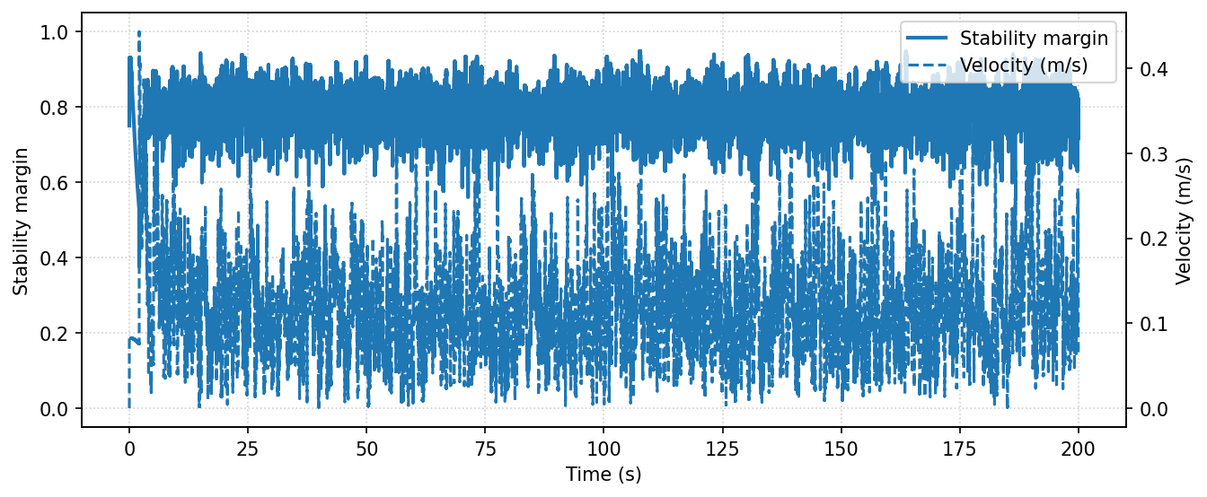
Analysis of Simulation
Stability and Velocity Analysis

Slide 6
Mission
The primary objective of the rover is to autonomously traverse a set of pre-defined waypoints W = {w₁, w₂, . . . , w_{N} } in a simulated lunar environment.
Our Approach : Visual Inertial Odometry with Extended Kalman Filter for state estimation.

Slide 7
Visual Inertial Odometry
Visual–Inertial Odometry (VIO) is a state estimation technique that fuses camera images with inertial measurements from an IMU to continuously estimate a robot’s 3D position, orientation, and velocity over time.
Optical flow tracks 2D feature points across frames.
IMU provides high-frequency motion and scale information.
EKF fuses both to estimate camera pose and velocity robustly.

Slide 8
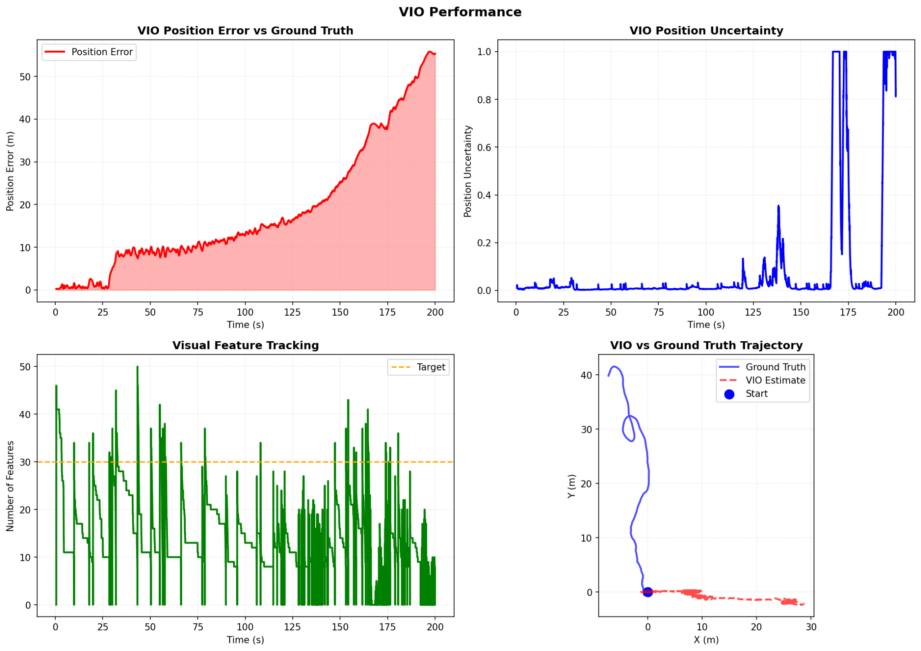
Experimental Results

Slide 9
Future Work
Visual-Inertial Odometry (VIO): Track static terrain features to correct wheel slip and provide EKF updates.
Terrain Enhancement: Introduce distinctive features (e.g., craters) to improve keypoint detection and VIO robustness.
Active Traction Control: Monitor wheel velocity vs. IMU acceleration to minimize slip and improve wheel odometry reliability.

Slide 10
Thank you

